Slide 3
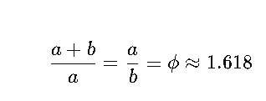
Golden Ratio:
The Golden Ratio is an irrational number, roughly 1.6180339887..., which has been of interest to mathematicians, artists, and architects for centuries. A simple way to understand it is through a line segment. If you divide a line into two parts such that the ratio of the whole line to the longer part is the same as the ratio of the longer part to the shorter part, this ratio is the Golden Ratio.
Mathematically:
This special ratio appears in various natural phenomena, art, and architecture. It's known for creating aesthetically pleasing proportions and can be found in structures like the Parthenon and even in the patterns of some plants.

Slide 4
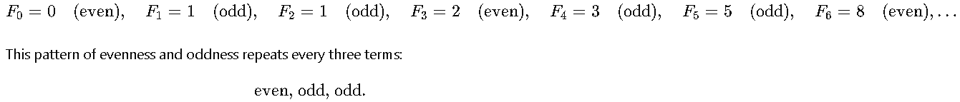
To prove a property of the Fibonacci sequence using contraposition, we’ll start by recalling what a proof by contraposition entails:
If we want to prove a statement of the form "If PPP, then QQQ", we can instead prove its contrapositive: "If not QQQ, then not PPP".
Proposition:
For this example, let's prove the following property using contraposition:
If a number FnF_nFn​ in the Fibonacci sequence is even, then nnn is divisible by 3.
So we want to prove: If FnF_nFn​ is even, then nnn is divisible by 3.
The contrapositive of this statement is:
If nnn is not divisible by 3, then FnF_nFn​ is odd.
If we can prove the contrapositive, it will also prove our original statement.
Proof by Contraposition
Restate the Contrapositive: We need to prove that if nnn is not divisible by 3, then FnF_nFn​ is odd.
Examine the Fibonacci Sequence Modulo 2: Let’s look at the Fibonacci sequence modulo 2 (only considering whether each term is even or odd).
Observing the sequence, we see that the terms repeat in a specific pattern for evenness and oddness:

Slide 5
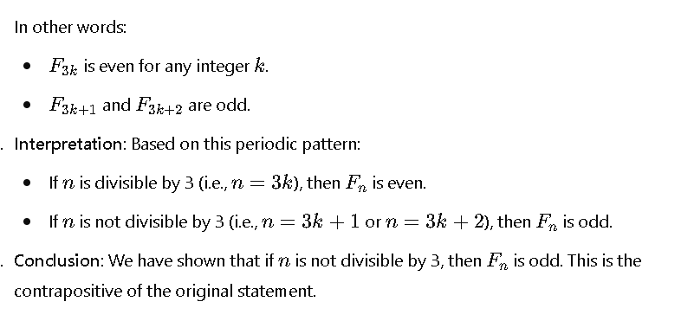
In other words:
F3kF_{3k}F3k​ is even for any integer kkk.
F3k+1F_{3k+1}F3k+1​ and F3k+2F_{3k+2}F3k+2​ are odd.
Interpretation: Based on this periodic pattern:
If nnn is divisible by 3 (i.e., n=3kn = 3kn=3k), then FnF_nFn​ is even.
If nnn is not divisible by 3 (i.e., n=3k+1n = 3k+1n=3k+1 or n=3k+2n = 3k+2n=3k+2), then FnF_nFn​ is odd.
Conclusion: We have shown that if nnn is not divisible by 3, then FnF_nFn​ is odd. This is the contrapositive of the original statement.
Thus, by contraposition, we have proven that if FnF_nFn​ is even, then nnn must be divisible by 3.

Slide 6
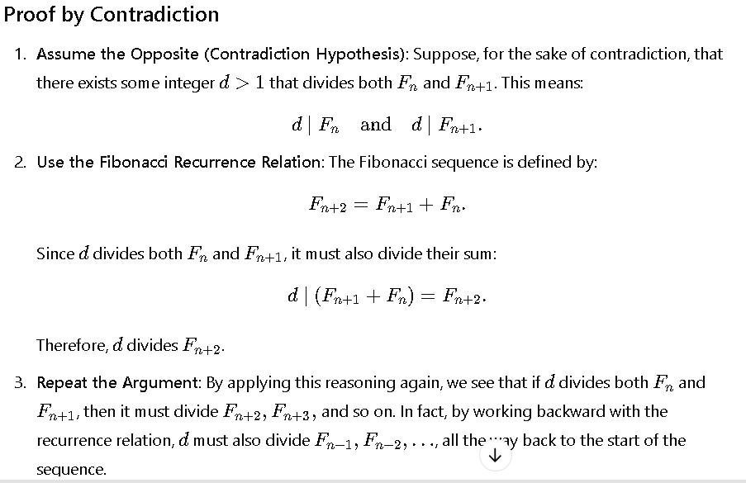
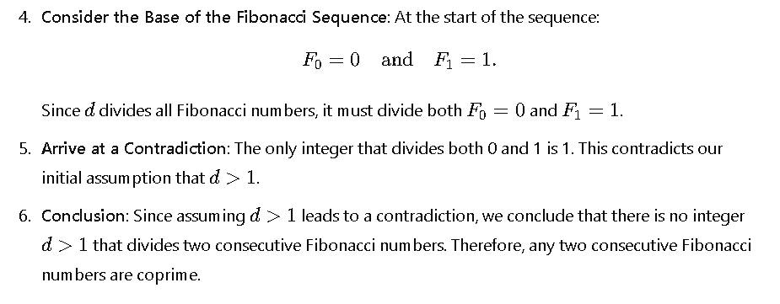

Slide 7

Fibonacci Sequence and the Golden Ratio
The Fibonacci sequence is a series of numbers where each term is the sum of the two preceding ones:
0,1,1,2,3,5,8,13,21,34,…0, 1, 1, 2, 3, 5, 8, 13, 21, 34…
Interestingly, as you progress through the Fibonacci sequence, the ratio of consecutive Fibonacci numbers (e.g., 5/3, 8/5, 13/8) gets closer and closer to the Golden Ratio. Specifically:

